Slide 1

EAB
Meeting
Results 2019/2020
&
Working Plan
2020/2021
European Initiative
for the exchange of young officers inspired by Erasmus
The Initiative
Erasmus
Militaire
EMILYO
Military
Erasmus

Slide 2
Meetings 2019/2020 under the umbrella of the Implementation Group
4 IG meetings (quarterly) ➔ number of participants is increasing (70-80)
  2 x Brussels
  1 x Bucharest
  1 x VTC
Annual LoD-9 meeting (AWL/Wroclaw/PL)
LoD-10 meeting (NDU/Veliko Tarnovo/BG)
Several other LoD meetings (Air Force, Navy, Technical)
Several EUMSSF meetings
iMAF 2020 postponed (COVID-19)

Slide 3
LoD
Lines of Development
LoD No. | LoD Name | Solved | On-going
1 | System of Equivalences | R
2 | Development of Competences | R | S
3 | Development of IDL/e-learning | R | S
4 | Create an IT-Platform (www.emilyo.eu) | R
5 | (Legal) Framework | R
6 | National Implementation of the Programme | R | S
7 | Financing the Initiative | R | S
8 | Common Modules | R | S
9 | Future Projects | R | S
10 | Gender Mainstreaming | R | S
11 | International Naval Semester | R | S
12 | International Air Force Semester | R | S
13 | International Technical Semester | R | S
14 | Research & Development |  | S
15 | International Medical Semester |  | S
- | (European Union Military Secondary Schools Forum) | R | S

Slide 4
CM
Common Modules (as of 03 Sep 2020)
Common Module | ECTS |  | Common Module | ECTS
Advanced Technologies in Borders Surveillance | 2 |  | Individual Personal Development and Meta-Communication | 2
Aviation English for ICAO LPR | 3 |  | Interoperability | 6
Aviation English P1 | 3 |  | Irregular Warfare | 3
Aviation English P2 | 3 |  | Law of Armed Conflict | 2
Basic Military English | 2 |  | Leadership & Agility in Complex Environments | 2
Battle Physical, Mental and Survival Training | 3 |  | Leadership in Communication - IMLA | 2
Biosafety and Bioterrorism | 2 |  | Leadership, Motivation and Influence - IMLA | 2
Common Operating Environment | 3 |  | Maritime Leadership | 2
Common Security and Defence Policy | 2 |  | Maritime Security | 2
Comprehensive Approach | 4 |  | Military Ethics (A) | 2
CMO/PSO (4 Sub-Modules [A, B, C, D]) | 12 |  | Military Ethics (B) | 2
Crisis Management (Military Leadership) – IMLA | 2 |  | Military Instructor Training | 3
Cross Cultural Communication | 2 |  | Military Leadership (A) | 2
CSDP-Olympiad | 2 |  | Military Leadership (B) | 2
Cultural Awareness | 2 |  | Military Leadership (C) | 4
Cyber Security | 2 |  | Military Strategy and Security in the Baltic Sea Region | 3
Defence and Security Economics | 4 |  | Senior Cadets’ Seminar on Leadership | 1.5
Electronic Warfare | 2 |  | Small Unit Tactics | 4
English for Aircraft Maintenance SET P1 | 3 |  | Space Applications for Security and Defence | 2
English for Aircraft Maintenance SET P2 | 3 |  | Stress Management - IMLA | 2
English for Aircraft Maintenance SET P3 | 3 |  | NCM Infantry Officer Winter Warfare Basic Module (EE) | 2
English for Aviation Security Personnel | 3 |  | NCM Close Quarter Battle (LV) | 3
Fighting In Built Up Area | 3 |  | NCM Troop Leading Procedures (LV) | 1
How to meet the Media | 2 |  | NCM Technologies in Cyber Security (PL) | 2
 |  |  | Total: 48 | 130.5

Slide 5
Events 2019/2020 under the umbrella of the Implementation Group

Slide 6
Events 2019/2020 under the umbrella of the Implementation Group

Slide 7
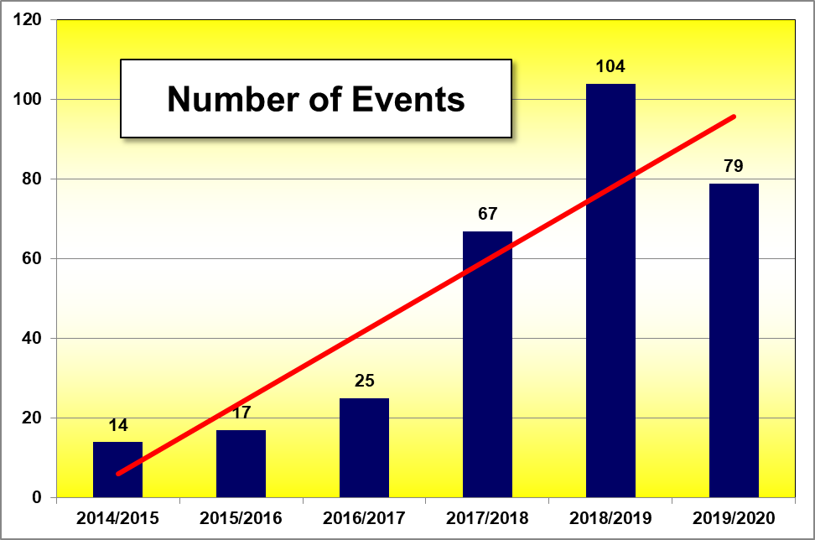
Events 2019/2020 under the umbrella of the Implementation Group
trendline

Slide 8
Statistics 2019/2020 participating Officer Cadets/Students

Slide 9
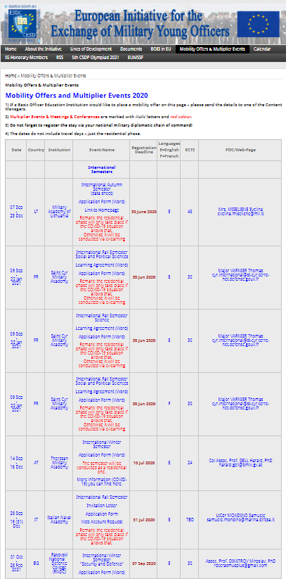
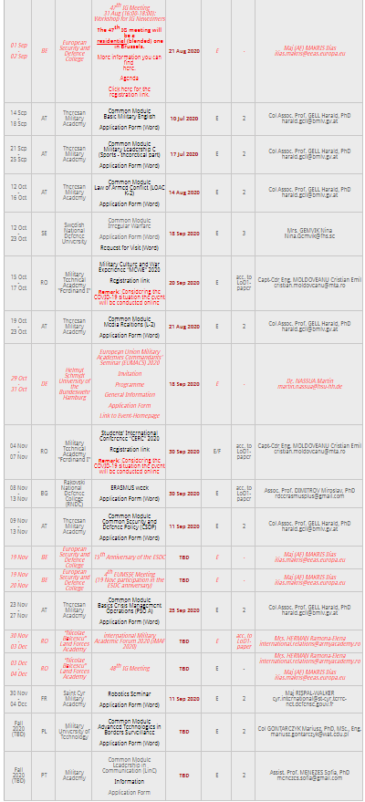
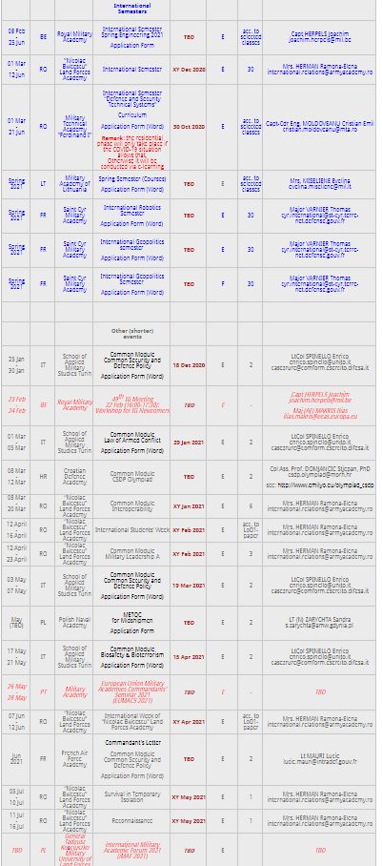
Working Plan 2020/2021 under the umbrella of the Implementation Group (1)
See EMILYO homepage (http://www.emilyo.eu/node/878)

Slide 10
Working Plan 2019/2020 under the umbrella of the Implementation Group (2)
4 IG meetings (2 days or more)
LoD meetings (e.g.: Air Force succeeded in SPP)
2 EUMACS (DE / PT)
CSDP-Olympiad (HR)
iMAFs (RO? / PL)
~20 international semesters
Common Modules
Seminars & other meetings at BOEIs

Slide 11

Working Plan 2020/2021 under the umbrella of the Implementation Group (3)
Promotion of
the Initiative:
  EUMACS 2020 (DE)
  EUMACS 2021 (PT)
  iMAF 2020 (RO)?
  iMAF 2021 (PL)
  Letter to all (Rector-)
  Commandants/
  Superintendents
  Promotion at BOEIs
  LoD meetings
Publication ➔ ➔

Slide 12
Request
Prolongation
of the task of the project oriented EAB-configuration
for another study year

Slide 13

thank YOU
for YOUR
attention!

